Slide 1
Chapter 1. A Tour of Computer Systems
Section 1.5 ~ 1.7
Juyoung Kim
https://github.com/keltion
July 4, 2021

Slide 2
Contents
◼︎ 1.5 Caches Matter
• cache ︎
◼︎ 1.6 Storage Devices Form a Hierarchy ︎
◼︎ 1.7 The Operating System Manages the Hardware
• Processes
￮ context switching
￮ thread
• Virtual memory
• FIles

Slide 3
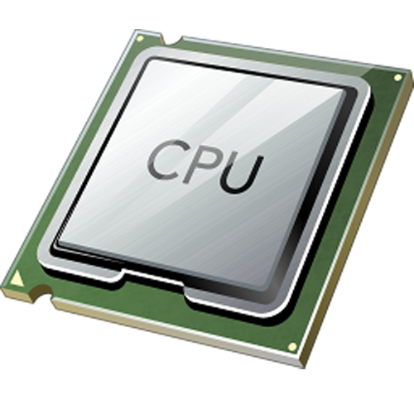
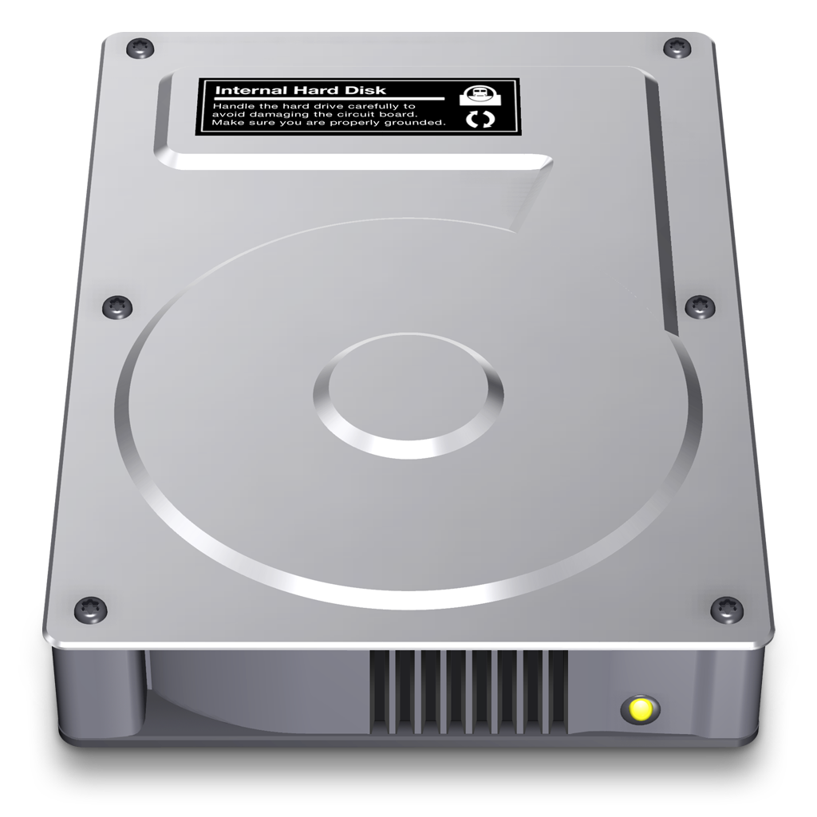
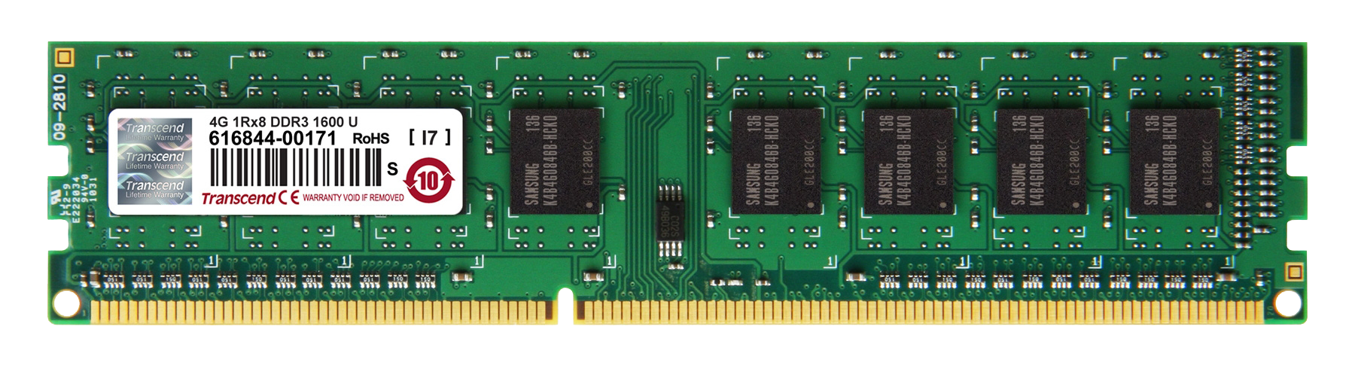
1.5 Caches Matter
• What is Cache?
- A cache is a storage device that helps you access information faster than usual
- It is used to deal with processor-memory gaps.
- Caches serve as temporary staging areas for information that the processor is likely to need in the near
future.(locality)
ms | 10⁻³s
μs | 10⁻⁶s
ns | 10⁻⁹s
speed
100ns
10ms

Slide 4
1.5 Caches Matter
• What is Cache?
- A cache is a storage device that helps you access information faster than usual
- It is used to deal with processor-memory gaps.
- Caches serve as temporary staging areas for information that the processor is likely to need in the near
future.(locality)
1
2
3
4
A
B
C
D

Slide 5
1.5 Caches Matter
• What is Cache?
- A cache is a storage device that helps you access information faster than usual
- It is used to deal with processor-memory gaps.
- Caches serve as temporary staging areas for information that the processor is likely to need in the near
future.(locality)
2
1
3
4
A
B
C
D

Slide 6
1.5 Caches Matter
• What is Cache?
- A cache is a storage device that helps you access information faster than usual
- It is used to deal with processor-memory gaps.
- Caches serve as temporary staging areas for information that the processor is likely to need in the near
future.(locality)
2
3
1
4
A
B
C
D

Slide 7
1.5 Caches Matter
• What is Cache?
- A cache is a storage device that helps you access information faster than usual
- It is used to deal with processor-memory gaps.
- Caches serve as temporary staging areas for information that the processor is likely to need in the near
future.(locality)
2
3
4
1
A
B
C
D

Slide 8
1.5 Caches Matter
• What is Cache?
- A cache is a storage device that helps you access information faster than usual
- It is used to deal with processor-memory gaps.
- Caches serve as temporary staging areas for information that the processor is likely to need in the near
future.(locality)
1
2
3
4
A
B
C
D

Slide 9
1.5 Caches Matter
• What is Cache?
- A cache is a storage device that helps you access information faster than usual
- It is used to deal with processor-memory gaps.
- Caches serve as temporary staging areas for information that the processor is likely to need in the near
future.(locality)
1
2
3
4
A
B
C
D

Slide 10
1.5 Caches Matter
• What is Cache?
- A cache is a storage device that helps you access information faster than usual
- It is used to deal with processor-memory gaps.
- Caches serve as temporary staging areas for information that the processor is likely to need in the near
future.(locality)
2
1
3
4
A
B
C
D

Slide 11
1.5 Caches Matter
• What is Cache?
- A cache is a storage device that helps you access information faster than usual
- It is used to deal with processor-memory gaps.
- Caches serve as temporary staging areas for information that the processor is likely to need in the near
future.(locality)
2
3
1
4
A
B
C
D

Slide 12
1.5 Caches Matter
• What is Cache?
- A cache is a storage device that helps you access information faster than usual
- It is used to deal with processor-memory gaps.
- Caches serve as temporary staging areas for information that the processor is likely to need in the near
future.(locality)
2
3
4
1
A
B
C
D

Slide 13
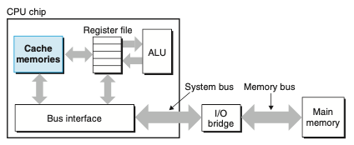
1.5 Caches Matter
• What is Cache?
- A cache is a storage device that helps you access information faster than usual
- It is used to deal with processor-memory gaps.
- Caches serve as temporary staging areas for information that the processor is likely to need in the near
future.(locality)

Slide 14
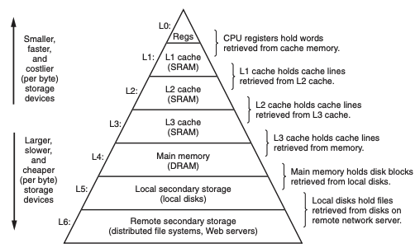
1.6 Storage Devices Form a Hierarchy
• Storage Hierarchy
- The main idea of a memory hierarchy is that storage at one level serves as a cache for storage
at the next lower level
- On some networked systems with distributed file systems, the local disk serves as a cache for
data stored on the disks of other systems.
Figure 1.9 An example of a memory hierarchy
Notes:
분산 파일 시스템이란 무엇입니까?
분산 파일 시스템은 클라이언트/서버 아키텍처를 기반으로 데이터를 저장하고 액세스하기 위한 솔루션입니다. 데이터는 중앙 스토리지 디바이스에 저장되지만 로컬 클라이언트 시스템에 저장된 것처럼 액세스되고 처리됩니다. 분산 파일 시스템을 사용하면 동일한 네트워크에 있는 사용자가 제어되고 권한이 부여된 방식으로 파일의 정보를 쉽게 공유할 수 있습니다.
Chapter 6 will have much more to say about this.

Slide 15
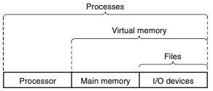
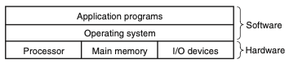
1.7 The Operating System Manages the Hardware (1/6)
• Operating System
- All attempts by an application program to manipulate the hardware must go through the operating system.
- Primary purposes
￮ to protect the hardware from misuse by runaway applications
￮ to provide applications with simple and uniform mechanisms for manipulating complicated and often
wildly different low-level hardware devices
- The operating system achieves both goals via the fundamental abstractions
￮ Processes
￮ Virtual memory
￮ FIles
Notes:
Os는 하드웨어를 사용할 수 있도록 도와준다
Q1. 추상화를 통해서 어떻게 첫번째 목적을 이룰까
실행중인 프로그램을 Process라는 객체를 만들고 이 객체에 대한 정보를 가지고 context switch등. 하드웨어 권한을 제한함?

Slide 16
1.7 The Operating System Manages the Hardware (2/6)
￮ Processes
- OS’s abstraction for a running program.
- Each process appears to have exclusive use of the hardware.
Hello
Chrome
Power Point

Slide 17
1.7 The Operating System Manages the Hardware (2/6)
￮ Processes
- OS’s abstraction for a running program.
- Each process appears to have exclusive use of the hardware.

Slide 18
1.7 The Operating System Manages the Hardware (2/6)
￮ Processes
- OS’s abstraction for a running program.
- Each process appears to have exclusive use of the hardware.
Hello
Chrome
Power Point

Slide 19
1.7 The Operating System Manages the Hardware (2/6)
￮ Processes
- OS’s abstraction for a running program.
- Each process appears to have exclusive use of the hardware.
Chrome
Power Point
Hello

Slide 20
1.7 The Operating System Manages the Hardware (2/6)
￮ Processes
- OS’s abstraction for a running program.
- Each process appears to have exclusive use of the hardware.
Hello
Power Point
Chrome

Slide 21
1.7 The Operating System Manages the Hardware (2/6)
￮ Processes
- OS’s abstraction for a running program.
- Each process appears to have exclusive use of the hardware.
Hello
Chrome
Power Point

Slide 22
1.7 The Operating System Manages the Hardware (2/6)
￮ Processes
- OS’s abstraction for a running program.
- Each process appears to have exclusive use of the hardware.
Chrome
Power Point
Hello

Slide 23
1.7 The Operating System Manages the Hardware (2/6)
￮ Processes
- OS’s abstraction for a running program.
- Each process appears to have exclusive use of the hardware.
Hello
Power Point
Chrome

Slide 24
1.7 The Operating System Manages the Hardware (2/6)
￮ Processes
- OS’s abstraction for a running program.
- Each process appears to have exclusive use of the hardware.
Hello
Power Point

Slide 25
1.7 The Operating System Manages the Hardware (2/6)
￮ Processes
- OS’s abstraction for a running program.
- Each process appears to have exclusive use of the hardware.
Hello

Slide 26
1.7 The Operating System Manages the Hardware (2/6)
￮ Processes
- OS’s abstraction for a running program.
- Each process appears to have exclusive use of the hardware.

Slide 27
1.7 The Operating System Manages the Hardware (2/6)
￮ Processes
- OS’s abstraction for a running program.
- Each process appears to have exclusive use of the hardware.
▪︎ context switching
Hello
Chrome
Power Point
The operating system performs this interleaving with a mechanism known as context switching.

Slide 28
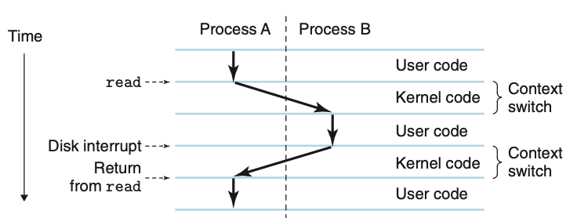
1.7 The Operating System Manages the Hardware (3/6)
▪︎ Context Switching
- Context Switching involves storing the context or state of a process so that it can be reloaded when
required and execution can be resumed from the same point as earlier.
- The operating system keeps track of all the state information that the process needs in order to run.
-> This state, which is known as the context, includes information such as the current values of the PC, the
register file
Program
Process
Notes:
example scenario: the shell process and the hello process. Initially, the shell process is running alone, waiting for input on the command line. When we ask it to run the hello program, the shell carries out our request by invoking a special function known as a system call that passes control to the operating system.
he operating system saves the shell’s context, creates a new hello process and its context, and then passes control to the new hello process. After hello terminates, the operating system restores the context of the shell process and passes control back to it, where it waits for the next command-line input.
한 프로세스에서 다른 프로세스로의 전환은 운영 체제 커널에 의해 관리됩니다.
응용 프로그램이 파일 읽기 또는 쓰기와 같은 운영 체제의 조치를 필요로 할 때 특수 시스템 호출 명령을 실행하여 제어를 커널로 전송합니다. 그런 다음 커널은 요청 된 작업을 수행하고 응용 프로그램으로 돌아갑니다.
Q2. 쉘이 운영체제에게 전달하는 시스템호출함수는 무엇인지, 프로세스 제어전달이 어떻게 이뤄지는지,
프로세스 추상화를 구현하려면 저수준 하드웨어와 운영 체제 소프트웨어 간의 긴밀한 협력이 필요합니다.
Thread : 13

Slide 29
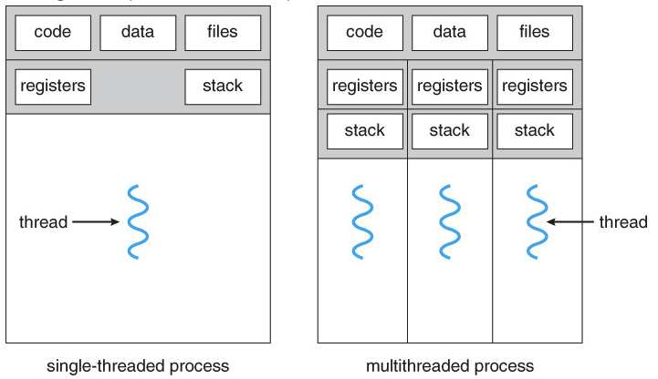
1.7 The Operating System Manages the Hardware (4/6)
￮ Threads
- A thread is a path of execution within a process. A process can contain multiple threads.
Notes:
스레드란? https://www.geeksforgeeks.org/thread-in-operating-system/
스레드의 효율성
Chap 12에서 자세히
스레드는 프로세스 내에서 실행되는 흐름의 단위이므로 특정 프로세스에 반드시 포함된다. 하나의 프로세스는 하나 이상의 스레드를 갖는다. 즉, 프로세스 내에서도 처리 흐름이 여러개가 될 수 있다. 하지만 운영체제는 프로세스 단위로 메모리를 할당하므로, 같은 프로세스 소속의 스레드는 메모리를 공유한다. (스레드도 각자의 스택영역을 보유하므로 완전히 공유한다고 보기는 어렵다.) 출처: https://preamtree.tistory.com/10 [Preamtree의 행복로그] Each process has the same uniform view of memory, which is known as its virtual address space.

Slide 30
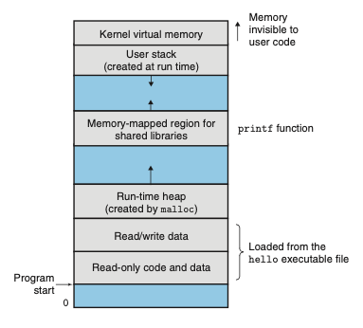
1.7 The Operating System Manages the Hardware (5/6)
￮ Virtual Memory
- abstraction that provides each process with the illusion that it has exclusive use of the main memory.
- Each process has the same uniform view of memory, which is known as its virtual address space
Notes:
Near the middle of the address space is an area that holds the code and data for shared libraries such as the C standard library and the math library
Q3. 커널을 다 공통으로 가지고있다면 굳이 다시 복사하는 이유가 뭘까

Slide 31
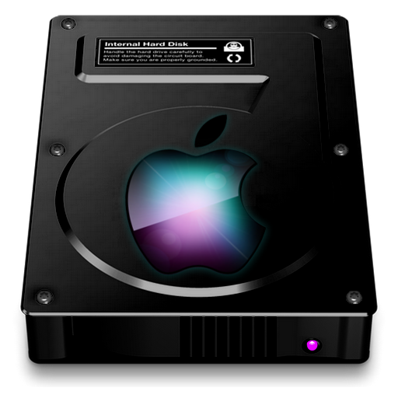
1.7 The Operating System Manages the Hardware (6/6)
￮ File
- A file is a sequence of bytes.
- Every I/O device, including disks, keyboards, displays, and even networks, is modeled as a file.
- All input and output in the system is performed by reading and writing files, using a small set of system
calls known as Unix I/O.
Program
user
file
file
file
Notes:
Chapter 10

Slide 32
QnA

Slide 33
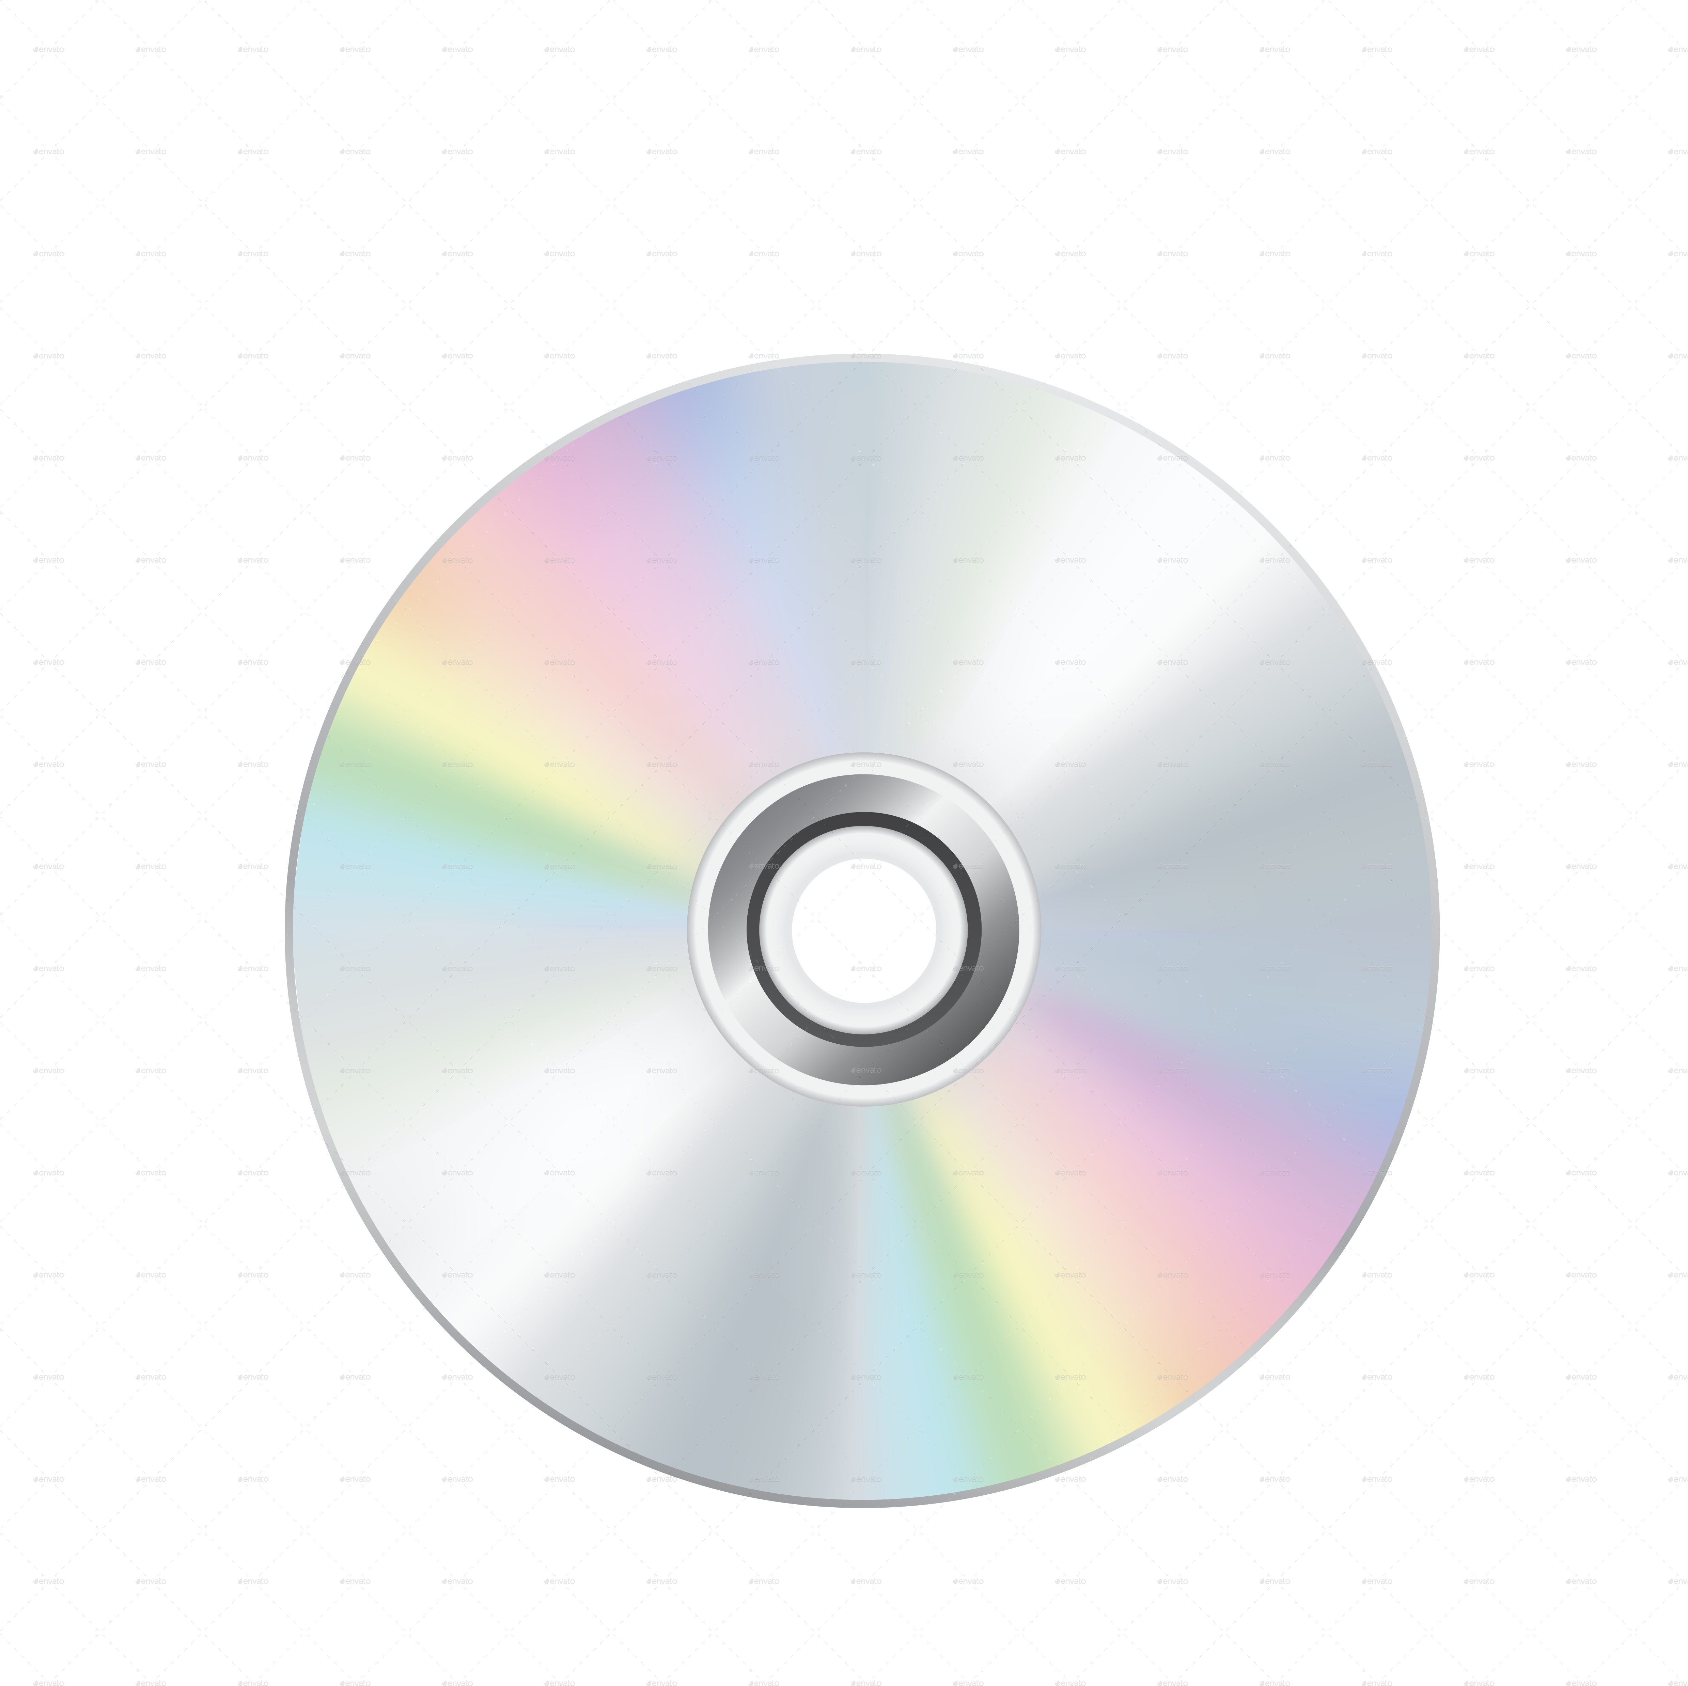
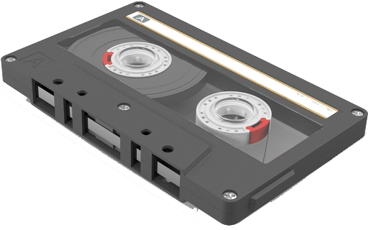
Appendix
• RAM
Random Access Memory
- 마구잡이
- 메모리 내에서 지정된 주소로 바로 튈 수 있음
• SAM
Sequential Access Memory
Notes:
메인메모리, 캐시 둘다 전원을 끄면 날라가는 RAM
근데 캐시는 좀 빨라야해서 SRAM을 사용

